Slide 1
ASYMMETRIC AUTHENTICATION
DR. O. I. ADELAIYE

Slide 2
OUTLINE
Using Asymmetric Crypto. For Authentication
Distributing Public Keys
X.509 Certificates

Slide 3
ASYMMETRIC AUTHENTICATION
Keys are generated as a pair
Mathematically related, but not possible to derive one from the other
One key is known by only one entity: private key
The other is known by everyone: public key
Either keys can be used for encryption
The other is used for decryption
Using public keys for encryption ensures confidentiality
Using private keys for encryption ensures authentication

Slide 4
AUTHENTICATION
Asymmetric Cryptography
Each user has a private and a public key
Bob needs to know the public key of Alice in order to authenticate her
Encrypting using a Private key: Signature
Only Alice can make it,
Every body can verify it

Slide 5
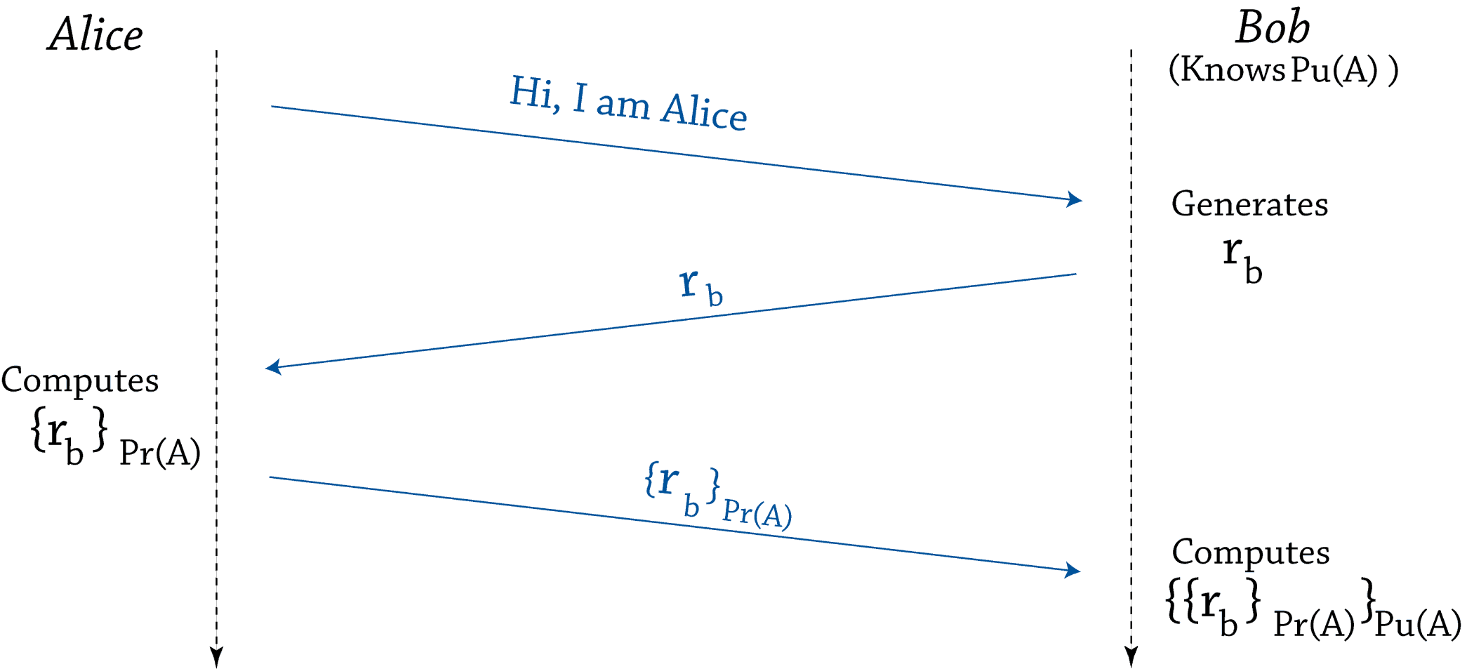
ASYMMETRIC ENCRYPTION FOR AUTHENTICATION
Pu(A) (resp. Pr(A)) is Alice public (resp. private) key

Slide 6
ASYMMETRIC ENCRYPTION FOR AUTHENTICATION
Advantage
Even if Alice wants to prove her identity to more than one user, she only needs to know her private key If Alice uses symmetric encryption, she needs to generate as many keys as authenticators
Problem
Poor performance, asymmetric encryption is more processor and time consuming than symmetric encryption and hash techniques
Solution
Sign a summary, or a “hash” of the message

Slide 7
HASH??
Message of any length
Eg. MD5 & SHA1
Hash Algorithm
Fixed length
(128 or 160)
Every message produces a different hash
Given a hash you cannot find the message
“Digital fingerprint” of the message

Slide 8
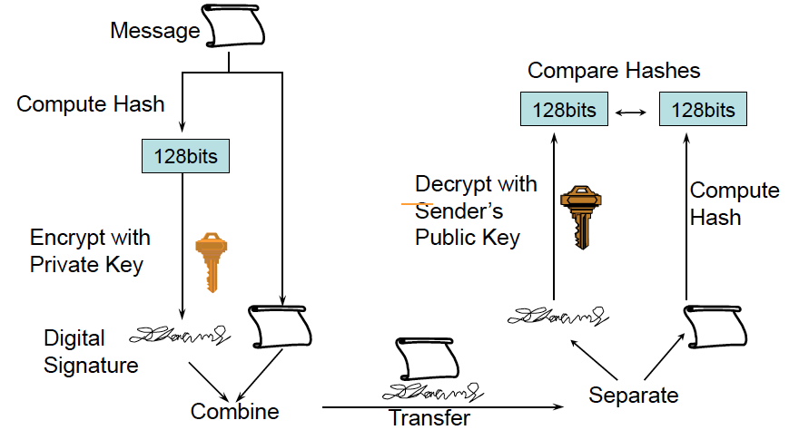
DIGITAL SIGNATURES

Slide 9
STORAGE OF PRIVATE KEYS
The signature is trusted if and only if no one except its owner can produce it
The private key can be stored
In an encrypted file, protected by a password
In a smart card, protected by a password or PIN

Slide 11
DISTRIBUTING PUBLIC KEYS

Slide 12
In a context where each user may need to prove his identity to others
Each user needs to know the public keys of the other users
Problem: How to distribute those keys
In a trustable way?
How to be sure that K is Alice’s public key?
Efficiently?
Each user needs to be able to know the public keys of all users she may authenticate
Give Bob the public key of Alice only when he needs to verify her identity

Slide 13
DISTRIBUTING PUBLIC KEYS
Three ways to distribute public keys:
Personally exchange public keys: not scalable
Get a public key from someone you trust (trusted introducer): not scalable
Get a certified key from a public repository: dynamic, scalable

Slide 14
DISTRIBUTING PUBLIC KEYS
Certificates
Trust a third party
Every one knows its public key
The trustable entity certifies that K is the public key of Alice
Alice provides her certificate to Bob when he verifies her identity
Public key certificates cannot be altered without detection
In practice
The trustable entity is called Certification Authority (CA)
Each user knows the public key of the CA
The CA generates a certificate for each user containing its name (Alice) and its key (Pu(Alice))

Slide 15
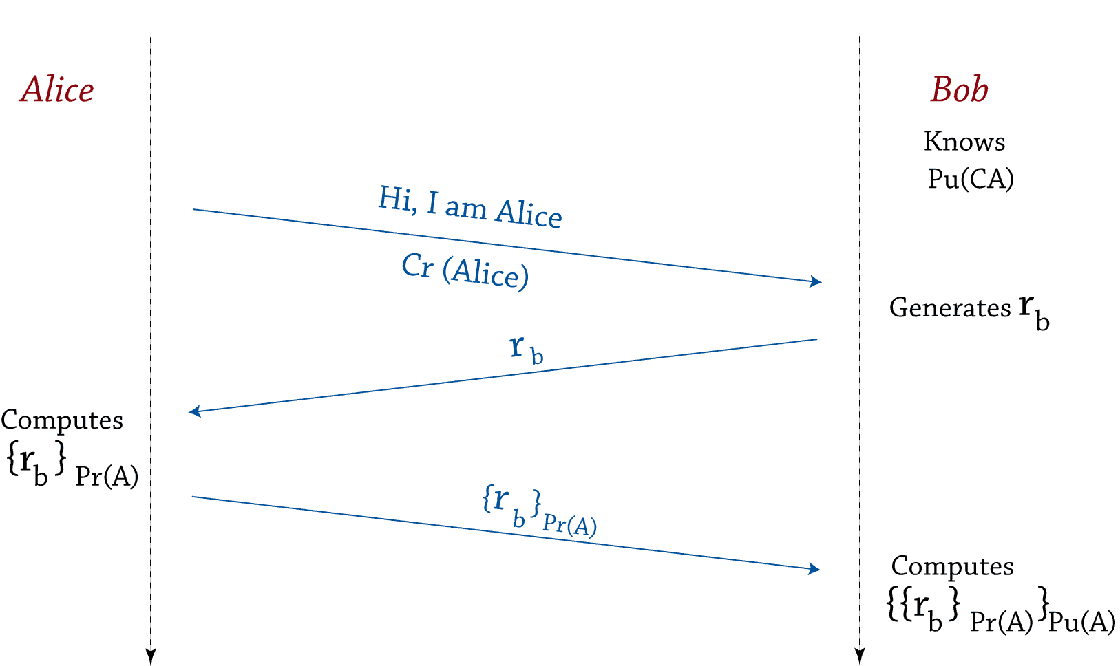
CERTIFICATES
Why does Bob need the challenge? What happens if it is Alice who generates the challenge

Slide 16
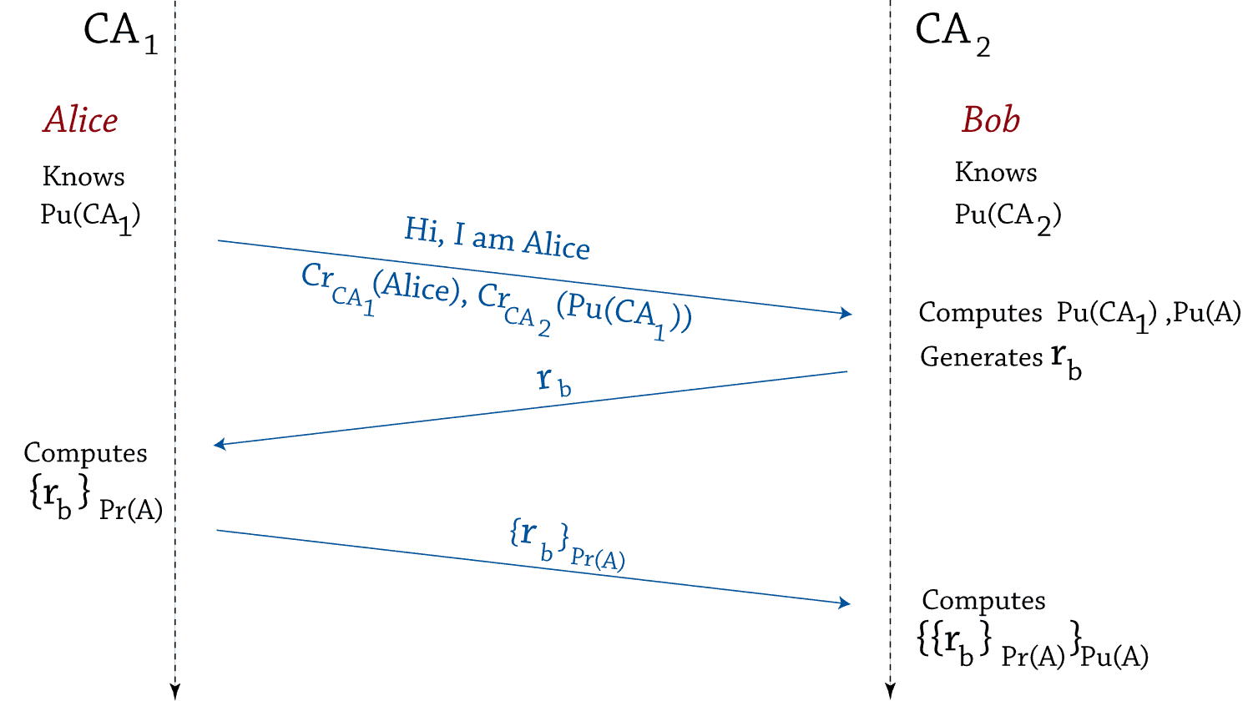
CERTIFICATES
In practice, there is no universally trusted entity (guess why?!): users are divided into domains
Domains are managed by different CA
How to allow Alice (CA₁) to prove her identity to Bob (CA₂)?
CA₂ signs a certificate for CA₁

Slide 17
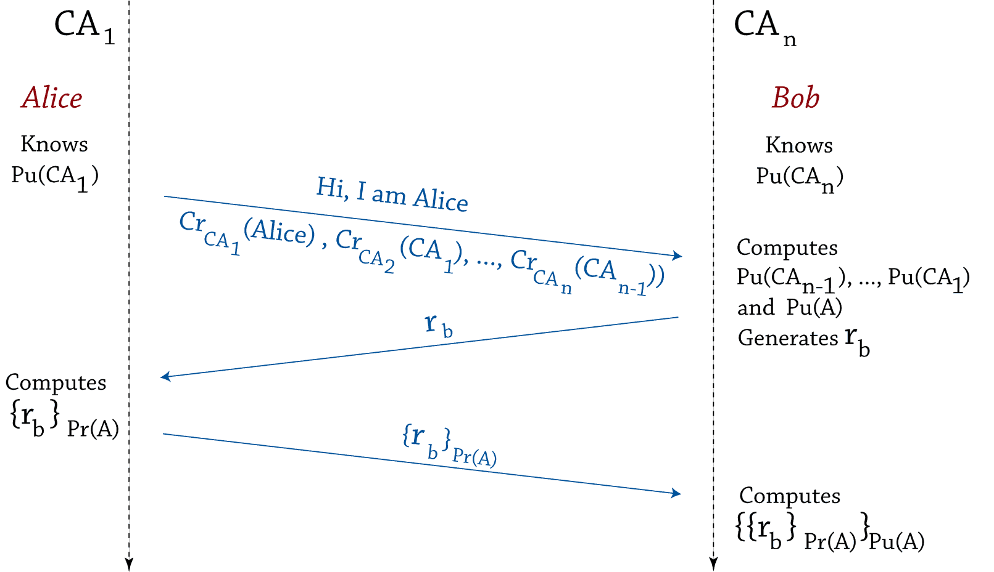
CERTIFICATES
More generally, certificate chains
CA_{n} is the trust anchor

Slide 18
CERTIFICATE FORMATS
X.509 format
Widely accepted international standard format
Used by Microsoft, Verisign, etc.
Used by S/MIME email
Signed by a single Certification Authority that has a globally unique name
PGP format
Allows multiple owner identities for a key
Allows multiple certifiers (CAs) for a key
User certifies his own key
Anyone else can also be a certifier
a user or a CA

Slide 19
TRUST MODELS
Monopoly Model (Centralized): one universally trusted entity
With Registration Authorities (RA): to check identities
With delegated CA: can issue certificates
Oligarchy: many trust anchors
Used in Browsers
Anarchy (Web of Trust): anyone can sign a certificate for anyone else
Pretty Good Privacy (PGP)

Slide 20
X.509 CERTIFICATES

Slide 21
PUBLIC KEY CERTIFICATE CONTENTS
Name/Identifying information of the key pair owner
The public key
Name of the authority that vouches for this binding
Validity period of the certificate
All the above Digitally Signed by the certifying authority

Slide 22
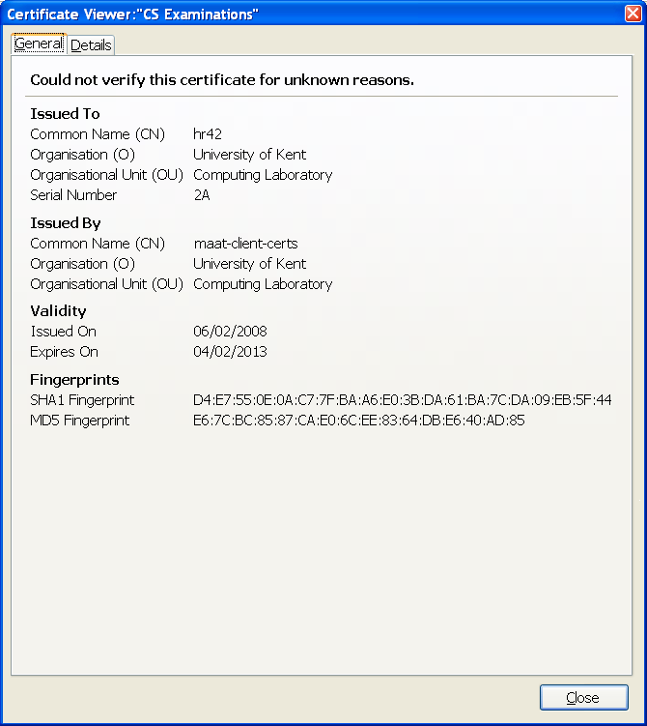
X.509 CERTIFICATES
My X.509 Certificate
Displayed in Firefox
Used to prove my identity to the exams system

Slide 23
X.509 CERTIFICATES
Moving X.509 Certificates and key pairs between applications
Certificates and key pairs can be moved in standard X.509 binary format (DER or Base64 encoded)
PKCS#12 is another standard format for moving key pairs (private keys and public key certificates) between applications e.g. Mozilla and IE
This file is encrypted and protected by a user provided PW
PKCS#7 is a standard format for moving public key certificates (and certificate chains to the root CA) between applications
Use the Import and Export capabilities of the applications

Slide 24
CERTIFICATE ISSUANCE
X.509
A CA issues certificates to its users and to subordinate CAs
PGP
User issues her own self signed certificate
Anyone else may choose to certify it by adding her signature on the certificate

Slide 25
CERTIFICATE REVOCATION
Certificates are good for a predefined period
It may happen that a certificate revocation is necessary
Private key is stolen
An employee is fired
A user forgets her password
In X.509: Similar to credit cards revocation
Old technique: publish a list of revoked cards (Certificates Revocation List)
New technique: check the validity of the card on-line (On-line Certificate Status Protocol)
In PGP: each signer can revoke her signature

Slide 26
WHO CAN PERFORM REVOCATION?
X.509 – only the CA can revoke the certificates it has issued
Revocation can be requested by the user, the CA administrator, or other trusted entity
PGP - key signers can revoke their individual signatures on a public key
PGP – only the key owner can revoke her own public key
This was a problem if you forgot your private key password, so in PGP 6 you can specify a designated revoker to act on your behalf

Slide 27
DISTRIBUTION OF REVOCATION INFORMATION
X.509
CRLs are published and distributed in the same way as the certificates, and by storing in LDAP directories and on Web pages
PKI X.509 (PKIX) group
Defined an Online Certificate Status Protocol so that a relying party can query an OCSP server to see if a certificate is valid. This is similar to how credit cards are checked by shopkeepers today.
PGP
Key signers and key owners should send their revoked signatures to key servers and to their PGP friends

Slide 28
END

